Slide 1
Decision Learning II
Session 24
Course : COMP6228 – Artificial Intelligence
Effective Period : February 2018

Slide 2
Learning Objective
After completing this session, students are expected to be able to:
LO 2 : Explain concepts of AI Techniques in Games
LO 3 : Designing AI game
LO 4 : Construct AI game

Slide 3
Content
Artificial Neural Networks
Machine Learning

Slide 4
Artificial Neural Network
Artificial neural networks (ANNs, or just neural networks for short) were at the vanguard of the new “biologically inspired” computing techniques of the 1970s. They are a widely used technique suitable for a good range of applications.
Like many biologically inspired techniques, collectively called Natural Computing (NC), they have been the subject of a great deal of unreasonable hype. In games, they attract a vocal following of pundits, particularly on websites and forums, who see them as a kind of panacea for the problems in AI.

Slide 5
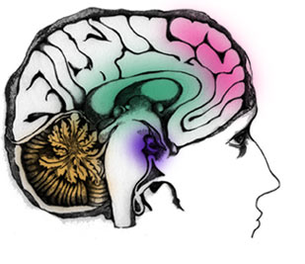
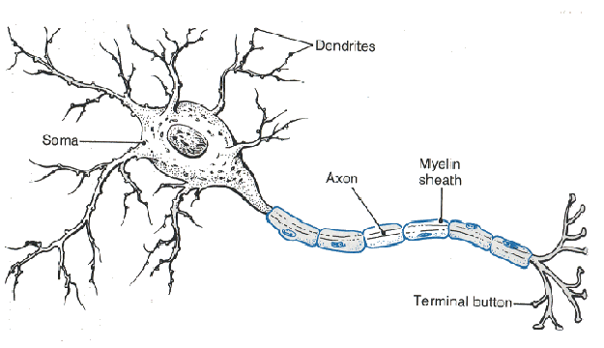
Artificial Neural Network

Slide 6
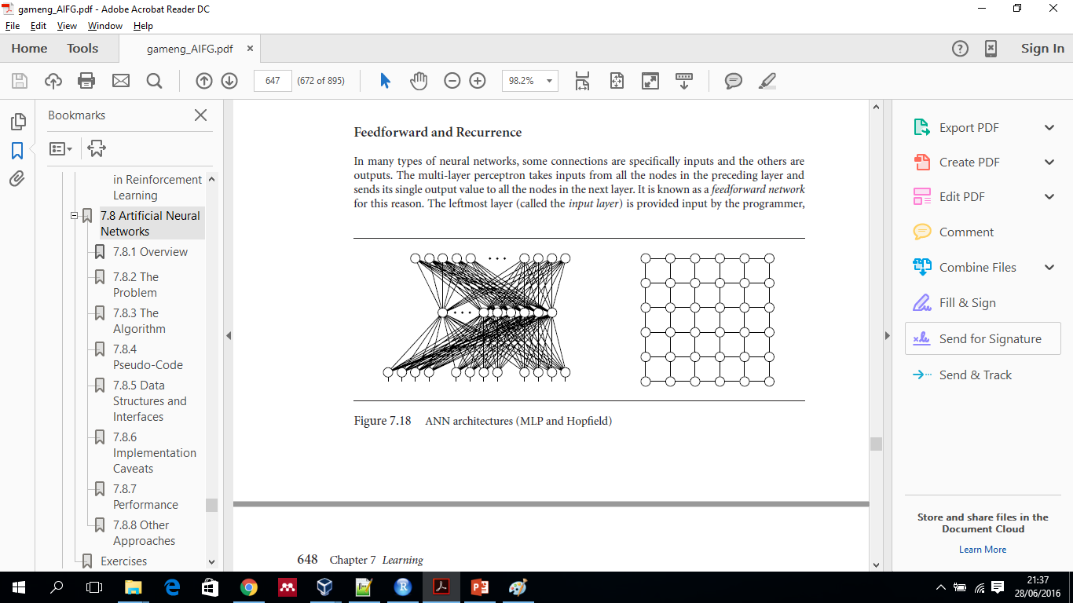
Artificial Neural Network
Neural networks consist of a large number of relatively simple nodes, each running the same algorithm.
These nodes are the artificial neurons, originally intended to simulate the operation of a single brain cell.
Each neuron communicates with a subset of the other artificial neurons in the network.
They are connected in patterns characteristic of the neural network type.
This pattern is the neural network’s architecture or topology.

Slide 7
Artificial Neural Network
Inspired by natural decision making structures (real nervous systems and brains)
If you connect lots of simple decision making pieces together, they can make more complex decisions
  Compose simple functions to produce complex functions
Neural networks:
  Take multiple numeric input variables
  Produce multiple numeric output values
  Normally threshold outputs to turn them into discrete values
  Map discrete values onto classes, and you have a classifier!
  But, the only time I’ve used them is as approximation functions

Slide 8
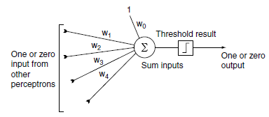
Artificial Neural Network
We can treat each neuron as an individual entity running its algorithm. The perceptron algorithm is shown figuratively in Figure below.
perceptron algorithm

Slide 9
Artificial Neural Network
Simulated Neuron – Perceptron
Inputs (a_{j}) from other perceptrons with weights (W_{i,j})
  Learning occurs by adjusting the weights
Perceptron calculates weighted sum of inputs (in_{i})
Threshold function calculates output (a_{i})
  Step function (if in_{i} > t then a_{i} = 1 else a_{i} = 0)
  Sigmoid g(a) = 1/1+e^{-x}
Output becomes input for next layer of perceptron
a_{j}
W_{i,j}
Σ W_{i,j} a_{j} = in_{i}
a_{i}
a_{i} = g(in_{i})

Slide 10
Artificial Neural Network
Neural Network Structure
Single perceptron can represent AND, OR not XOR
  Combinations of perceptron are more powerful
Perceptron are usually organized on layers
  Input layer: takes external input
  Hidden layer(s)
  Output layer: external output
Feed-forward vs. recurrent
  Feed-forward: outputs only connect to later layers
    Learning is easier
  Recurrent: outputs can connect to earlier layers or same layer
    Internal state

Slide 11
Artificial Neural Network
Neural network for Quake
Enemy
Dead
Four input perceptron
  One input for each condition
Four perceptron hidden layer
  Fully connected
Five output perceptron
  One output for each action
  Choose action with highest output
  Or, probabilistic action selection
    Choose at random weighted by output
Sound
Low Health
Attack
Wander
Spawn
Retreat
Chase

Slide 12
Artificial Neural Network
Learning Neural Networks
Learning from examples
  Examples consist of input and correct output
Learn if network’s output doesn’t match correct output
  Adjust weights to reduce difference
  Only change weights a small amount (η)
Basic perceptron learning
  W_{i,j} = W_{i,j} + η(t-o)a_{j}
  If output is too high (t-o) is negative so W_{i,j} will be reduced
  If output is too low (t-o) is positive so W_{i,j} will be increased
  If a_{j} is negative the opposite happens

Slide 13
Artificial Neural Network
Neural Network Example
Single perceptron to represent OR
  Two inputs
  One output (1 if either inputs is 1)
  Step function (if weighted sum > 0.5 output a 1)
Initial state (below) gives error on (1,0) input
  Training occurs
1
0.1
Σ W_{j} a_{j} = 0.1
0
g(0.1) = 0
0.6
0

Slide 14
Artificial Neural Network
Neural Network Example
Wj = Wj + η(t-o)aj
W1 = 0.1 + 0.1(1-0)1 = 0.2
W2 = 0.6 + 0.1(1-0)0 = 0.6
After this step, try (0,1)→1 example
  No error, so no training
0
0.2
Σ W_{j} a_{j} = 0.6
1
g(0.6) = 0
0.6
1

Slide 15
Artificial Neural Network
Neural Network Example
Try (1,0)→1 example
  Still an error, so training occurs
W₁ = 0.2 + 0.1(1-0)1 = 0.3
W₂ = 0.6 + 0.1(1-0)0 = 0.6
And so on…
  What is a network that works for OR?
  What about AND?
  Why not XOR?
1
0.2
Σ W_{j} a_{j} = 0.2
0
g(0.2) = 0
0.6
0

Slide 16
Artificial Neural Network
Neural Network Evaluation
Advantages
  Handle errors well
  Graceful degradation
  Can learn novel solutions
Disadvantages
  “Neural networks are the second best way to do anything”
  Can’t understand how or why the learned network works
  Examples must match real problems
  Need as many examples as possible
  Learning takes lots of processing
    Incremental so learning during play might be possible

Slide 17
Practical Machine Learning
Case Study
Character recognition neural networks
Recognition of both printed and handwrittencharacters is a typical domain where neural networks have been successfully applied
Optical character recognition systems were among the first commercial applications of neural networks

Slide 18
Practical Machine Learning
Case Study
We demonstrate an application of a multilayer feed forward network for printed character recognition.
For simplicity, we can limit our task to the recognition of digits from 0 to 9. Each digit is represented by a 5 ´ 9 bit map.
In commercial applications, where a better resolution is required, at least 16 ´ 16 bit maps are used.

Slide 19
Practical Machine Learning
Bit maps for digit recognition

Slide 20
Practical Machine Learning
How do we choose the architecture of a neural network?
The number of neurons in the input layer is decided by the number of pixels in the bit map. The bit map in our example consists of 45 pixels, and thus we need 45 input neurons.
The output layer has 10 neurons – one neuron for each digit to be recognized.

Slide 21
Practical Machine Learning
How do we determine an optimal number of hidden neurons?
Complex patterns cannot be detected by a small number of hidden neurons; however too many of them can dramatically increase the computational burden.
Another problem is overfitting. The greater the number of hidden neurons, the greater the ability of the network to recognize existing patterns. However, if the number of hidden neurons is too big, the network might simply memorize all training examples.

Slide 22
Practical Machine Learning
Neural network for printed digit recognition

Slide 23
Practical Machine Learning
What are the test examples for character recognition?
A test set has to be strictly independent from the training examples.
To test the character recognition network, we present it with examples that include “noise” – the distortion of the input patterns.
We evaluate the performance of the printed digit recognition networks with 1000 test examples (100 for each digit to be recognized).

Slide 24
References
Ian Millington. 2009. Artificial intelligence for games. Morgan Kaufmann Publishers. Burlington. ISBN:9780123747310
Stuart Russell. (2010). Artificial intelligence : a modern approach. 03. Pearson Education. New Jersey. ISBN: 9780132071482.
Learning System: http://www.myreaders.info/06_Learning_Systems.pdf

